Slide 1


Master thesis: Recognizing Urban Points of Interests with Convolutional Neural Networks
1st presentation
Andriy Zoryk

Slide 2
Agenda
Motivation
What is CNN?
Related works
Main tasks
Datasets
References

Slide 3
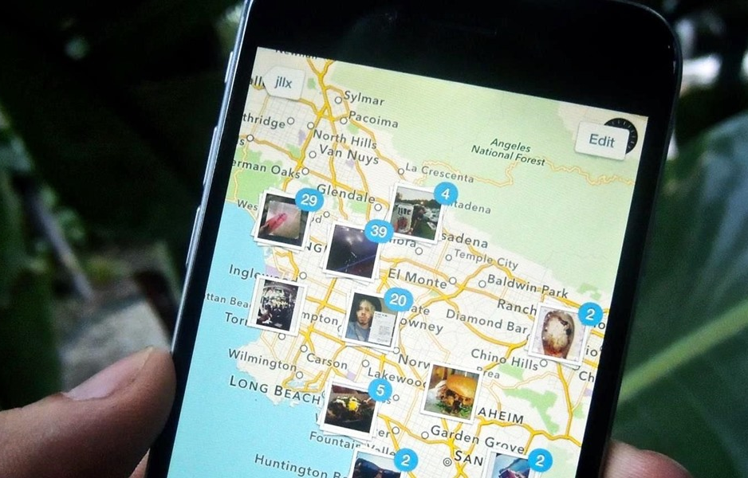
Motivation
In smartphones, additional information is automatically captured, such as longitude and latitude of where the image was taken
[image source: ios.gadgethacks.com]

Slide 4
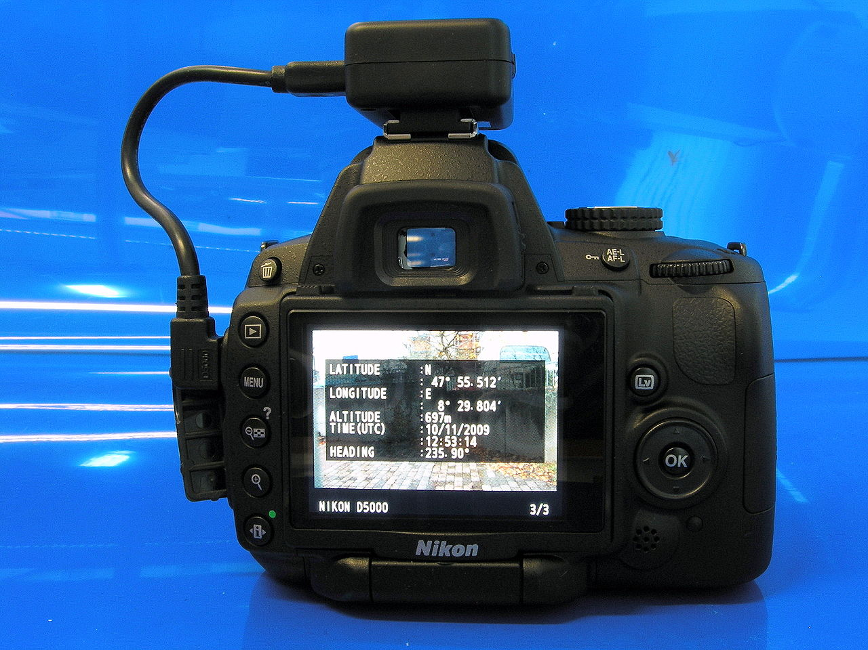
Motivation
Several manufacturers offer cameras with a built-in GPS receiver
Some digital cameras and camera phones support an external GPS receiver connected by cable, or inserted into the memory card slot or flash shoe.
[image source: commons.wikimedia.org]

Slide 5
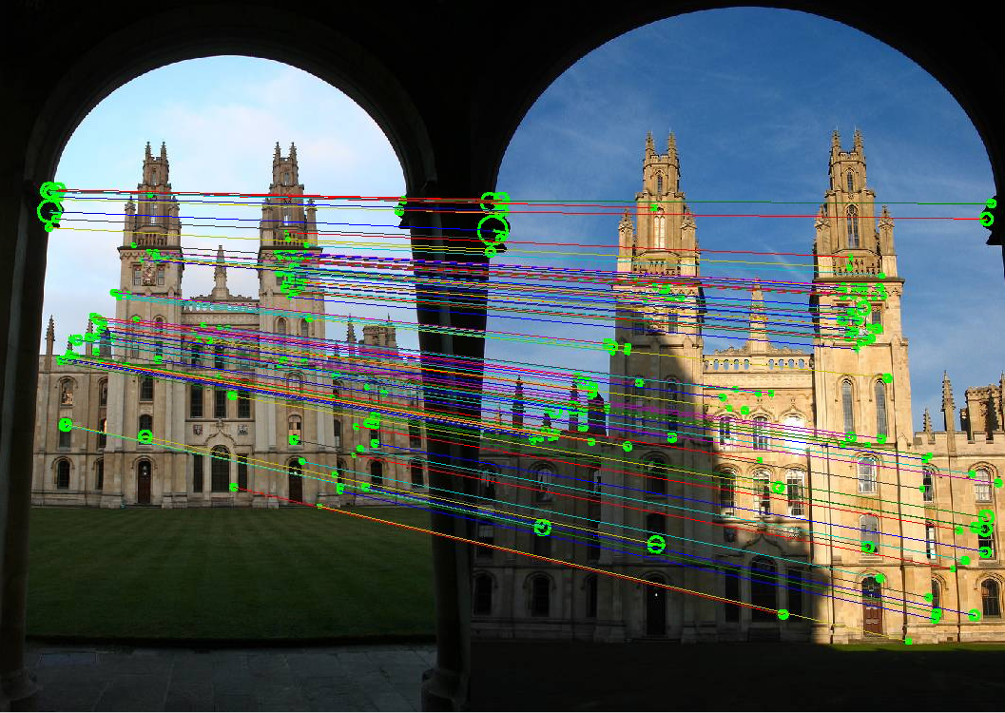
Main goal: geotagging of images of Urban Points of Interests with Convolutional Neural Networks
Motivation
[source: robots.ox.ac.uk]

Slide 6

What is CNN?
Convolutional neural networks, CNNs or ConvNets (LeCun, 1989), are a specialized kind of neural network for processing data that has a known, grid-like topology. [Goodfellow, Bengio, Courville. Deep Learning, 2016]
The name “convolutional neural network” indicates that the network employs a mathematical operation called convolution
[image source: graphics.cs.cmu.edu]

Slide 7
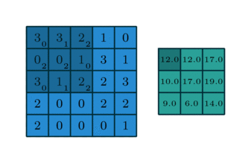
A convolution on an image
What is CNN?
Image: im of dimensions 5×5
Kernel: k of dimensions 3×3
[source: graphics.cs.cmu.edu]

Slide 8

A pooling layer (Max Pool)
What is CNN?
Fully connected layer
[image source: https://cambridgespark.com]

Slide 9
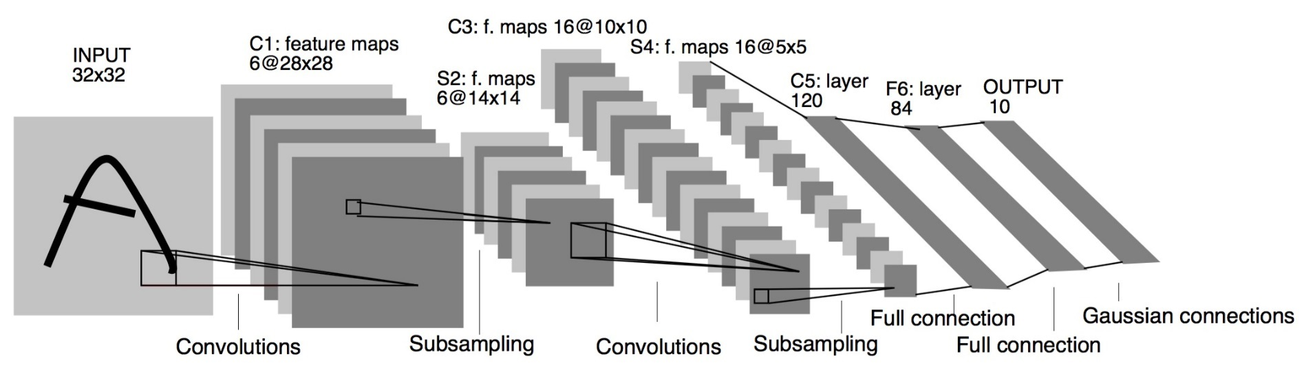
LeNet5 (LeCun, Bottou, Bengio, Haffner, 1998) Convolutional Neural Network for digits recognition
What is CNN?
one of the very first convolutional neural networks
pioneering work by Yann LeCun was named LeNet5
consists of 7 layers:
Cx: convolution layers with 5x5 filter
Sx: subsampling (pooling) layers
Fx: fully-connected layers
[LeCun et al., 1998]
Notes:
LeNet5 features can be summarized as:
convolutional neural network use sequence of 3 layers: convolution, pooling, non-linearity (key feature)
use convolution to extract spatial features
subsample using spatial average of maps
non-linearity in the form of tanh or sigmoids
multi-layer neural network (MLP) as final classifier
sparse connection matrix between layers to avoid large computational cost
In overall this network was the origin of much of the recent architectures, and a true inspiration for many people in the field.

Slide 10
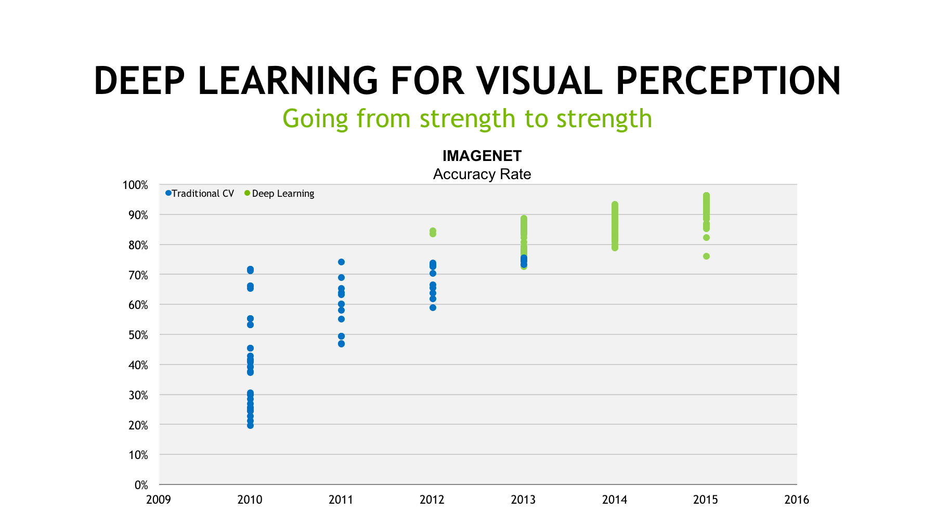
What is CNN?
[source: https://blogs.nvidia.com]

Slide 11
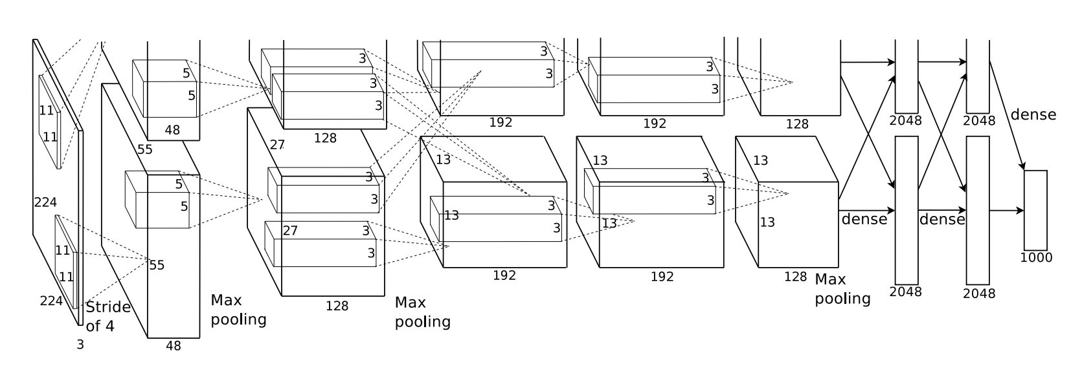
AlexNet (Krizhevsky, Sutskever, Hinton 2012) ImageNet Classification with Deep CNN
What is CNN?
Bigger model as LeNet (7 hidden layers, 650,000 units, 60 Mio parameters)
More data (10**6 vs. 10**3 images)
GPU implementation (50x speedup over CPU). Trained on two GPU for a week.
[Krizhevsky et al., 2012]

Slide 12
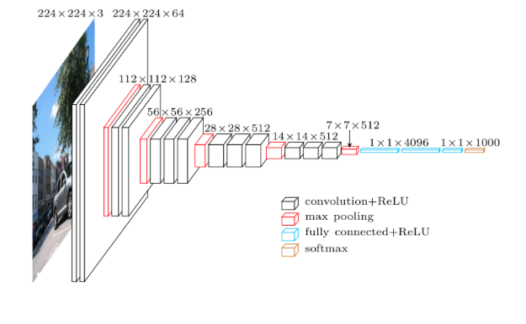
VGG-16, VGG-19 (Simonyan, Zisserman, 2014) Very deep convolutional networks for large-scale image recognition
What is CNN?
16- and 19-layer network used by the VGG team in the ILSVRC-2014 competition
much smaller 3×3 filters in each convolutional layers
[Simonyan, Zisserman, 2014]

Slide 13
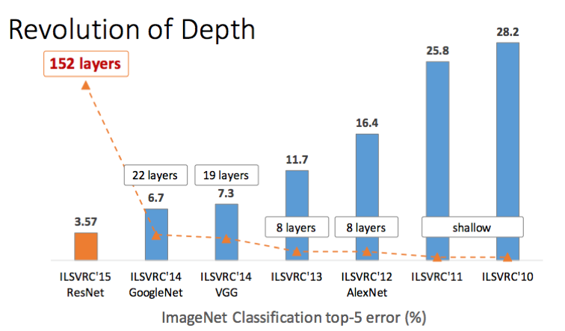
Going deeper
What is CNN?
[Kaiming He et al., 2014]

Slide 14
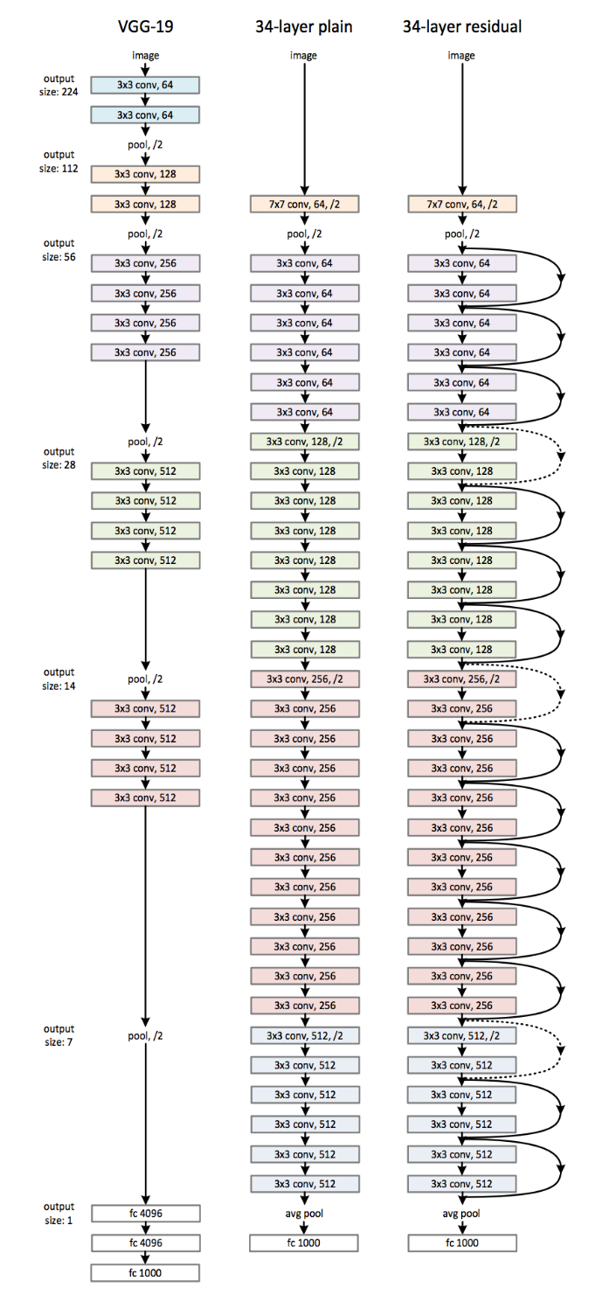
What is CNN?
ResNet (He, Zhang, Ren, Sun, 2015) Deep Residual Learning for Image Recognition
more efficient: 3.6 billion FLOPs comparing to 19.6 billion FLOPs in VGG-19
[Kaiming He et al., 2015]

Slide 15
Im2GPS (Hays and Efros, 2008) estimating geographic information from a single image
Related works
one of the first approaches to geolocate random pictures
Dataset - over 6 million GPS-tagged images from the Internet
[Hays, Efros, 2008]

Slide 16
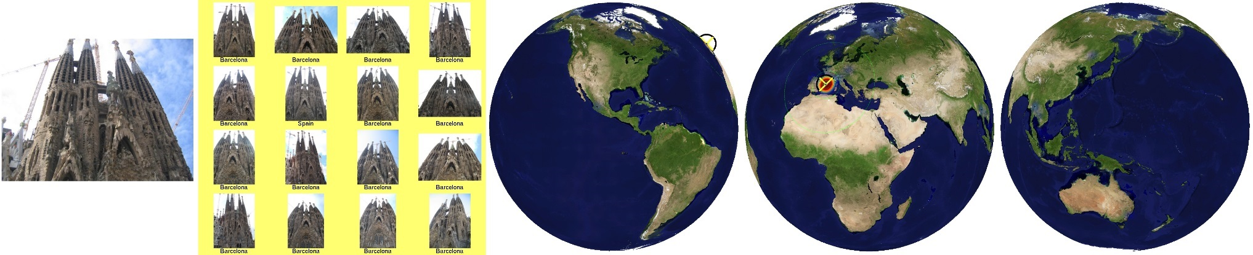
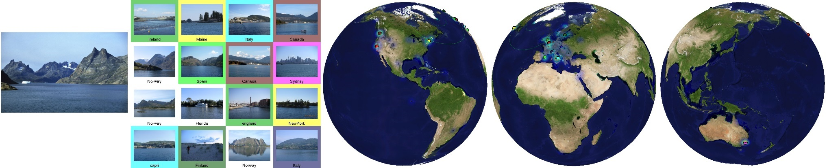
IM2GPS visualization
Related works
Each result shows the query image, a montage of the top 16 nearest neighbors from the database, and three views of the Earth
[source: http://graphics.cs.cmu.edu/projects/im2gps/results.html]

Slide 17
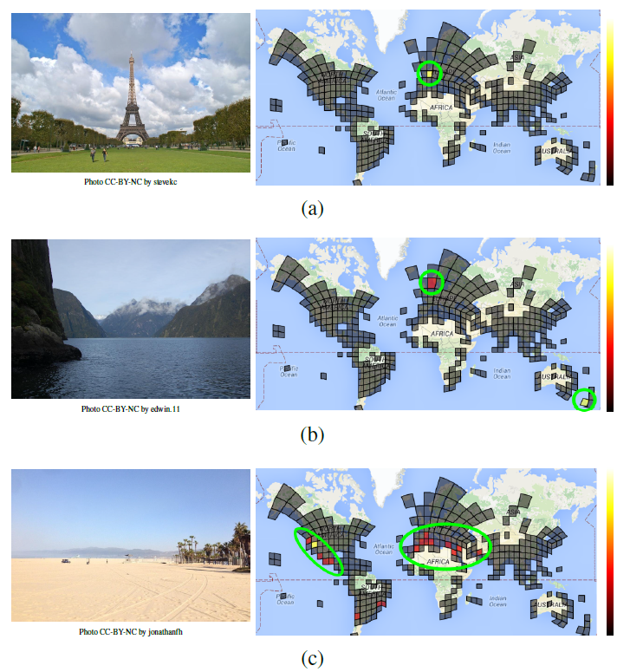
PlaNet (Weyand, Kostrikov, Philbin, 2016) Photo Geolocation with Convolutional Neural Networks
Related works
main goal – localize any type of photo taken in any location,
classification problem,
the partitioning of the earth’s surface into set of non-overlapping cells,
dataset of 126M photos with Exif geolocations mined from all over the web,
using deep network and an LSTM architecture.
[Weyand, Kostrikov, Philbin, 2016]

Slide 18
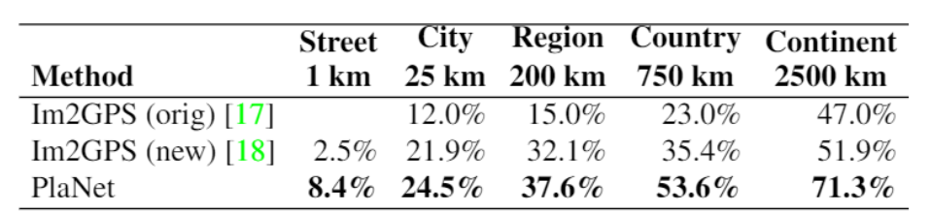
PlaNet (Weyand, Kostrikov, Philbin, 2016) Photo Geolocation with Convolutional Neural Networks
Related works
Comparison of PlaNet with Im2GPS. Percentages are the fraction of images from the Im2GPS test set that were localized within the given radius.
[source: Weyand, Kostrikov, Philbin, 2016]

Slide 19
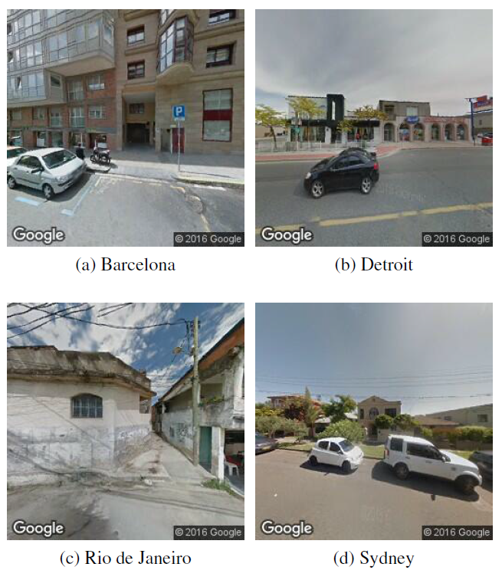
Little PlaNet (Hershey, Wulfe, 2016) Recognizing Cities from Street View Images
Related works
classification problem
dataset of 100K photos taken from Google Street View in 10 different cities,
was used GoogLeNet model pretrained on the Places205 dataset and the neural network library Caffe
LittlePlaNet achieves superhuman accuracy on this dataset, at a surprisingly high 75%
Randomized Street View Images from Four Cities
[source: Hershey, Wulfe, 2016]

Slide 20
Main tasks
Choose a framework
Use the GPU
Obtain a dataset

Slide 21
Datasets
Flickr
Google StreetView

Slide 22
Bamberg City Points of Interest
Flickr queries used to download images:
Bamberger Dom
Altes Rathaus
Kloster Michelsberg
Klein Venedig
Altenburg
Neue Residenz
Alte Hofhaltung

Slide 23
Chosen Frameworks
Python
numpy, scikit, opencv modules
Frameworks to choose:
Theano+Keras models
Tensorflow
Caffe

Slide 24
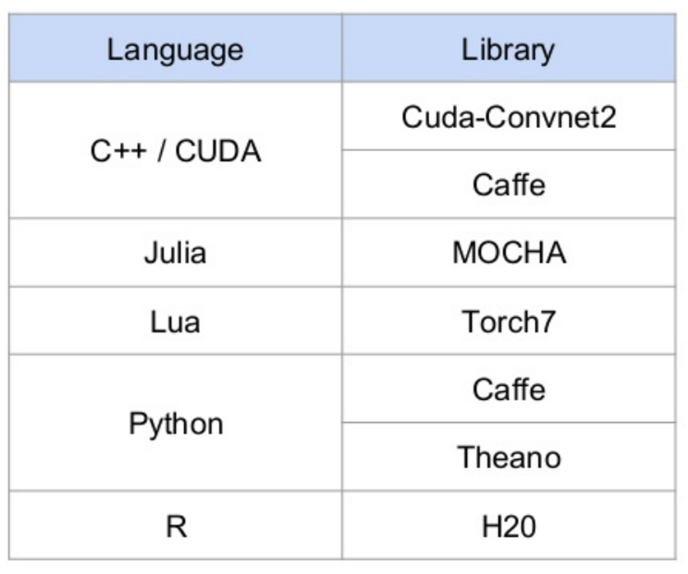
Choose a framework
[source: https://www.slideshare.net/didericksen/deep-learning-presentation]

Slide 25
References
Yann LeCun, Leon Bottou, Yoshua Bengio and Patrick Haffner. Gradient-Based Learning Applied to Document Recognition. 1998
J. Hays and A. Efros. IM2GPS: estimating geographic information from a single image. 2008.
Alex Krizhevsky, Ilya Sutskever, Geoffrey E. Hinton. ImageNet Classification with Deep Convolutional Neural Networks. 2012
Tobias Weyand, Ilya Kostrikov, and James Philbin. PlaNet - Photo Geolocation with Convolutional Neural Networks, 2016.
Hershey, D., & Wulfe, B. Recognizing Cities from Street View Images. 2016.
Charles Ollion, Olivier Grisel. Convolutional neural networks. Presentation at Master Datascience Université Paris Saclay. 2017
https://m2dsupsdlclass.github.io/lectures-labs/slides/03_conv_nets/

Slide 26
References

